Slide 1
Opportunities for Action:
2023
#eventscreatechange

Slide 2
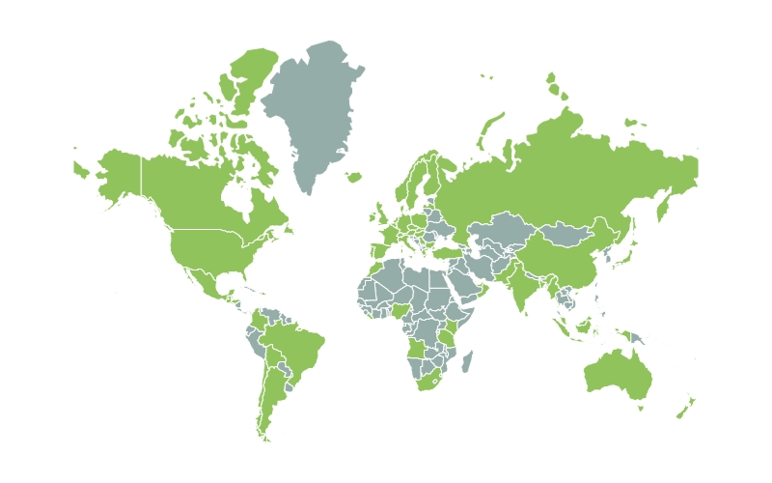
Using my Voice
As one of almost 2,000 Positive impact ambassadors around the world I am committed to using my voice to champion the creation of a sustainable event sector. This presentation is a summary of opportunities for action in 2023

Slide 3
2023 the year of Transparency
2023 is going to be the first time that engagement strategies, in other words events, are expected to meet reporting requirements, led by The Race to Zero. Events are now known for their negative environmental impact, and this is impacting attendee behavior, sponsorship and the role of events within business strategy. In 2023 event professionals have the opportunity to build the narrative of engagement strategies being used to advance the United Nations Sustainable Development Goals but this will require sharing measurement data, implementing international sustainability standards.
Transparency will be the theme for 2023, as we shift from a time when any sustainability initiative could be celebrated, to a time where public opinion and regulations expect evidence and data. 2023 is likely to include significant greenwashing in human engagement strategies with brand damaging results.
The following actions outlined in this presentation will prevent this.

Slide 4
ISO 20121 Animation
During 2023 ISO 20121, the only international standard for sustainability in events will be revised. There is the opportunity for the global event sector to be involved. This animation explains more.

Slide 5
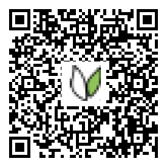
Iso 20121 Resources
Positive Impact have created toolkits to support event professionals to help them understand how they can be involved with ISO 20121, either as experts on working groups with national standard bodies or as liaison bodies representing communities of event professionals.
Use the QR code on this slide to access the toolkits.

Slide 6
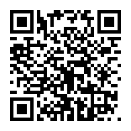
February 9th Event
Join Positive Impact, UNICEF UK, The International Olympic Committee, ISO and more for an informative session on ISO 20121 on February 9th at
12:00pm (GMT),
13:00pm (CET),
20:00pm (China Standard Time)
21:00pm (JST)
Everyone who registers for the event will receive a post event recording so don’t worry if this time does not work for your time zone.
Use the QR code on this slide to register for the free event.

Slide 7
Could you be a Liaison?
2023 is going to be a key year for the event sector associations because it will be the deciding time on whether associations will bring their sustainability efforts in line with international standards and best practice campaigns including The Race to Zero. These associations have received a letter inviting them to be a liaison during the revision of ISO 20121. Associations should listen to their members so if you would like your association to be involved please encourage them.
Sport and Sustainability International
Joint Meeting Industry Council
American Hotel & Lodging Association
ASAE & The Centre for Association Leadership
Association Forum
Association of Destination Management Executives International
Convention Sales Professionals International
Corporate Event Marketing Association
Destinations International
Event Services Professional Association
Exhibition Services & Contractors Association
Healthcare Convention and Exhibitors Association
Hospitality Sales and Marketing Association International
International Association of Venue Managers
International Association of Conference Centres
Incentive Research Foundation International
Association of Exhibitions & Events
International Association of Professional Congress Organisers
International Association of Speakers Bureaus
International Congress And Convention Association
International Live Events Association
Meetings Professionals International
National Association For Catering And Events
National Speakers Association
National Coalition of Black Meeting Professionals
PCMA
Religious Conference Management Association
Society of Government Meeting Professionals
Southern African Association for the Conference Industry
SITEU.S.
Travel Association
World Meetings Forum
The British Association for Sustainable Sport
Sports and Dev
Association for culture enterprise
New Zealand event association
Sport events and tourism Association
Association of Festival Organiser
The British and international federation of festival
Association of Independent Festivals
ACCED I
FIFA
UEFA
Society for sustainable events
UIA
SISO
ECM
SACEOS
ICCA
ABPCO
AIPC
asae
COCAL
EVVC
IAEE
IAPCO
Best Cities Alliance
Event industry Council
UFI

Slide 8
Human & Child Rights
ISO 20121 launched in 2012 inspired by the London Olympic and Paralympic Games. The revised ISO20121 is set to launch before the Paris 2024 Olympic and Paralympic Games. Sustainability and the expectations of event attendees has advanced since 2012 for example in the area of human and child rights and safeguarding, as this short animation explains.

Slide 9
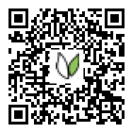
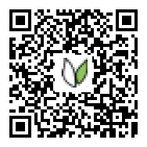
Take an Active Role
Use the QR code on this slide to access resources on human and child rights and safeguarding. This will be useful if you are taking an active role in the ISO 20121 revision process.

Slide 10
Race to Zero
As the world’s International standards body ISO is leading in using standards to meet carbon targets. At COP26 ISO made the London Declaration and there is the potential that ISO 20121 will be a leading example of how standards can be used to meet carbon requirements. This animation will explain The Race to Zero which is a UN campaign supported by over 4,000 of the world’s leading businesses, cities, universities and financial institutions.

Slide 11
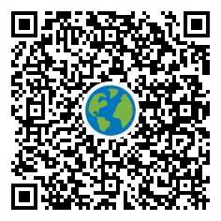
Race to Zero
Positive Impact is a Race to Zero Accelerator which means Positive Impact supports the global event sector, especially businesses with less than 500 employees to join The Race to Zero. Use the QR code on this slide to access resources on The Race to Zero.

Slide 12
SDG’s
Human engagement is vital to create a world that works for everyone. The United Nations Sustainable Development Goals are a framework with indicators so governments, businesses and society groups can measure progress. One of the UN SDG indicators is about ‘participation and inclusion in decision making’ and this indicator is useful for those who work in engagement strategies and events. In a time where it is possible to measure the carbon impact of engagement it is important that we remember the positive impact engagement can have, so we can understand if our use of carbon is justified.

Slide 13
Why are they important?
In the next few years it will be possible to understand how much carbon is being used to enable participation and inclusion in decision making processes that can further advance the UN SDGs. Therefore, this is likely to influence the approach taken to deliver events. This animation will give you ideas on how events can be used to advance the UN SDGs
-Positive Impact is an SDG mobiliser which means Positive Impact support the global event sector to take action on the SDGs.

Slide 14
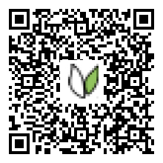
Acceleration Action:
It can seem overwhelming to know how to report on your sustainability approach. Positive Impact’s annual acceleration action report can be accessed through this QR code and it is an example of transparency and best practice reporting. If you are going to be reporting this year a good start would be to read and learn from this report.

Slide 15
CPD
During 2023 Heads of sustainability, event professionals and any of the supply chain delivering engagement will need to build their capacity and knowledge in credible sustainability initiatives.
Positive Impact has launched a series of education resources which are certified by the world’s leading and largest CPD accreditation organisation working across all industry sectors.
This means Heads of Sustainability and Heads of Marketing can now gain continuing professional development hours through Positive Impact’s education. Use the QR code on this slide to access these credible education resources

Slide 16
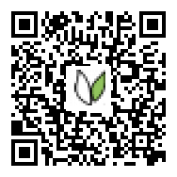
Become an Ambassador!
As a Positive Impact Ambassador I have a number of opportunities to develop myself and my leadership. Four times a year I receive a PowerPoint, like this one, which I can share. I can apply for discounts on education and gain continuing professional development hours from education which will be recognised by business CEOs around the world. I can attend regular events and I can volunteer to be the Positive Impact Ambassador who represents my geographical area. I can use the free resources provided by Positive Impact to be active on human rights, The Race to Zero, ISO 20121, The UN SDGs and more!
For these reasons I would encourage anyone to become a Positive Impact ambassador and together we can create a sustainable event sector so human engagement is delivered in a way that advances the sustainable development goals.
Use the QR code on this slide to register as a Positive Impact Ambassador!

Slide 17
Thank you for listening
@PIevents
@positiveimpactevents
www.positiveimpactevents.com

