Slide 1
What is credible action on sustainability for events?

Slide 2
In the following slides you will see 8 examples of credible action the global event sector could take TODAY to be sustainable and advance the SDGs
On each slide is a QR code with access to credible resources.
Some of the actions also have animations to bring to life the actions.
Implement ISO 20121
Carbon: Join the Race to Zero
Address Human Rights
Learn with CPD Certified Education
Collaborate with a global community of Ambassadors
Empower Others
Share a Positive Impact
Innovate
This content has been created by UN SDG Action Mobiliser Positive Impact to mark the 2023 Unite to Act Campaign

Slide 3
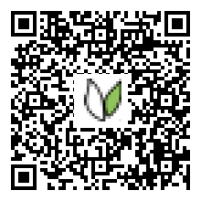
Implement ISO 20121
To advance SDG 9 implement ISO 20121, the international standard for a global event sector so sustainability is considered at every decision point during the planning and delivery of your event.

Slide 4
What is ISO 20121?

Slide 5
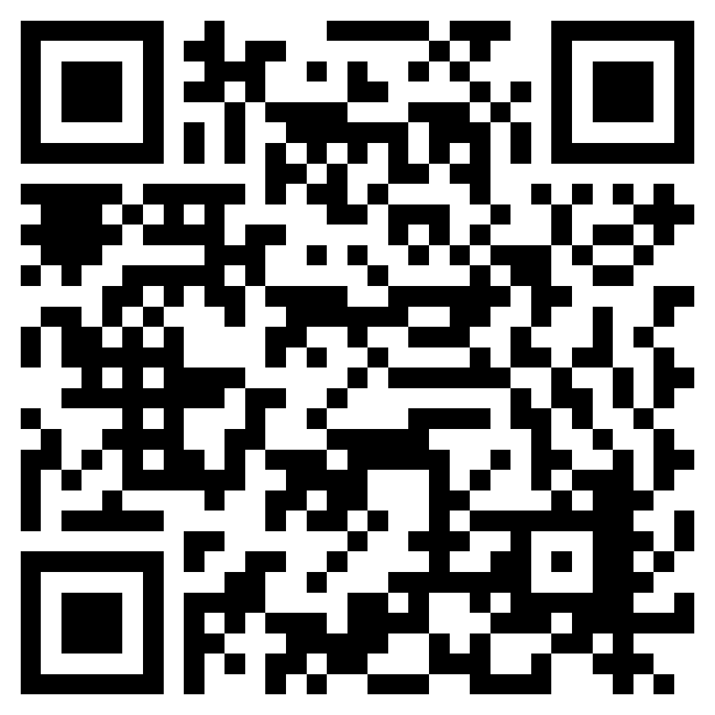
Carbon: Join The Race to Zero
To advance SDG 13 join The Race to Zero and advance the Paris Agreement
This content has been created by Race to Zero Positive Impact supported by SME Climate Hub

Slide 6
What is The Race to Zero?

Slide 7
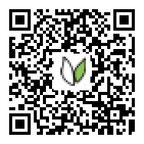
Address Human Rights
To advance SDG 10 use resources from UNICEF UK to understand how your event can be planned with a consideration for human and child rights and safeguarding.

Slide 8
What are Human Rights and what does this mean for events?

Slide 9
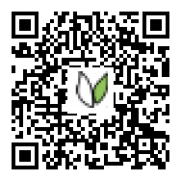
Learn with CPD Certified Education
To advance SDG 4 gain certified education hours
This content has been certified by CPD Certification Service, the world's leading and largest independent CPD accreditation organisation

Slide 10
What is CPD Certified Education?

Slide 11
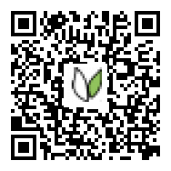
Collaborate with a Global Community of ambassadors
To advance SDG 11 become a Positive Impact Ambassador and join a community of over 1800 from over 60 countries.

Slide 12
Collaborate with a Global Community of ambassadors

Slide 13
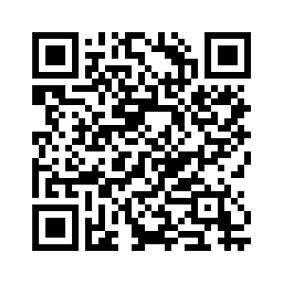
Empower Others
To advance SDG 16 use your voice to empower others and if you speak at an event use these resources to champion sustainability

Slide 14
Share a Positive Impact
To advance SDG 17 use this toolkit to share your actions

Slide 15
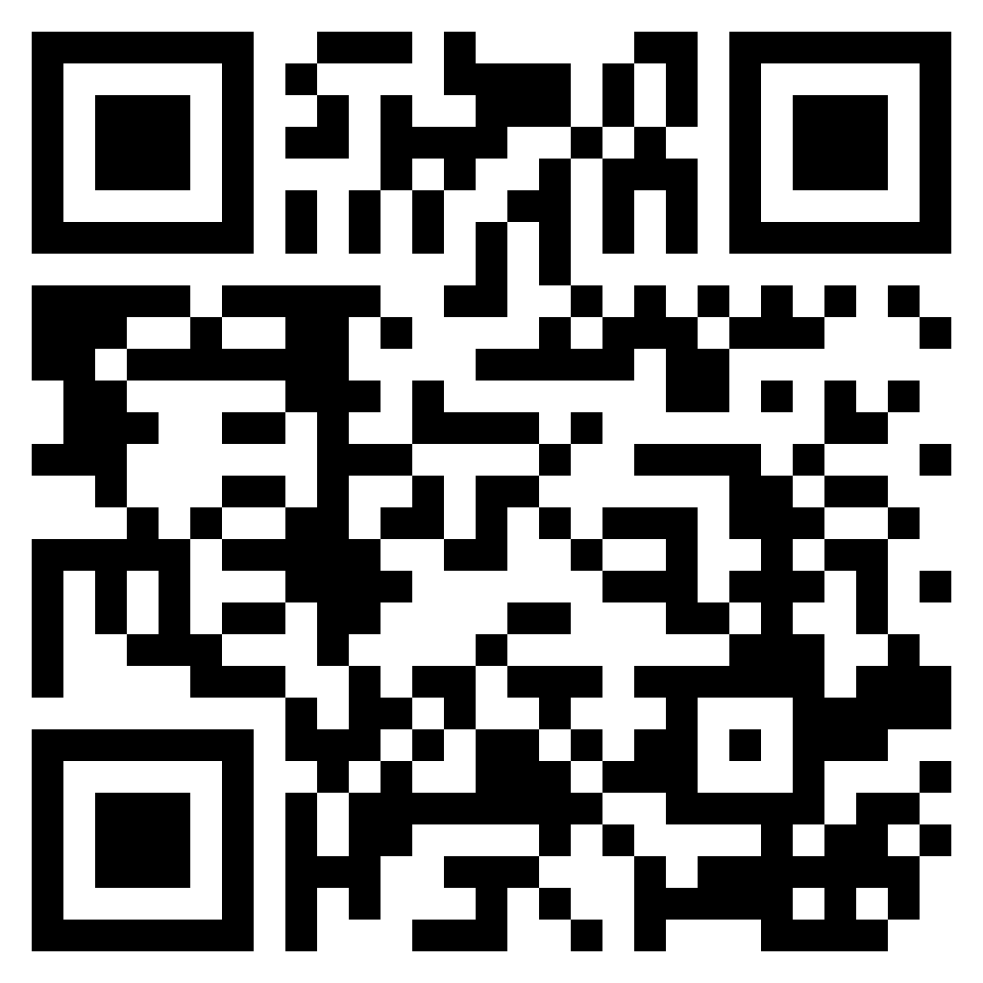
Innovate
To advance SDG 9 find credible and creative ways that your event and engagement strategies could be delivered sustainably

Slide 16
How can I find credible and creative ways to innovate?

Slide 17
Thank you for being in action to create a new future for how human engagement happens
You are now ready to:
Implement ISO 20121
Carbon: Join the Race to Zero
Address Human Rights
Learn with CPD Certified Education
Collaborate with a global community of Ambassadors
Empower Others
Share a Positive Impact
Innovate
Positive Impact is a not for profit which exists to provide education, engagement and collaboration to create a sustainable event sector.

