Slide 1
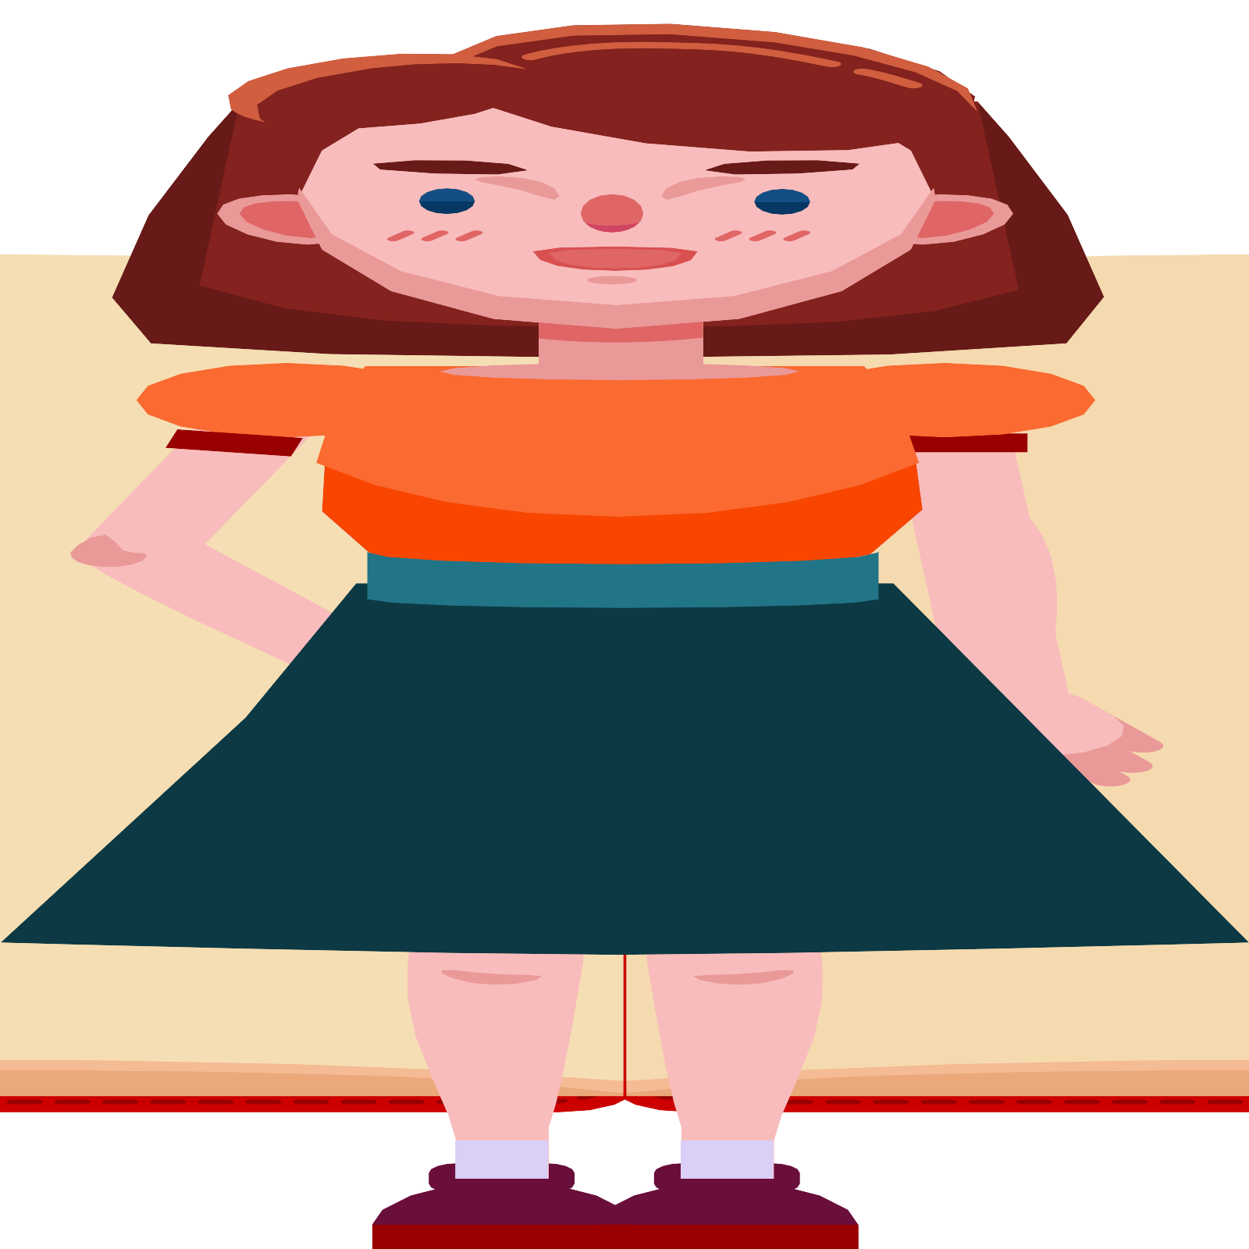
Guidance for considering human and child rights and safeguarding when planning an event
#eventscreatechange

Slide 2
Outcomes of presentation
Understand human and child rights and safeguarding
Understand why it is important to consider human and child rights and safeguarding when planning an event
Be equipped to implement guidance to consider human and child rights and safeguarding in line with ISO 20121
Learn practical steps to take to consider human and child rights and safeguarding when planning your event
Notes:
Script: Welcome to today’s short training workshop, created by Positive Impact and Unicef UK. This training programme has been designed to equip corporate event planners to understand how to implement the guidance Positive Impact and Unicef UK have developed to consider human and child rights and safeguarding when planning events.
By the end of this workshop, you should:
Understand human and child rights and safeguarding
Understand why it is important to consider human and child rights and safeguarding when planning an event
Be equipped to implement guidance to consider human and child rights and safeguarding in line with ISO 20121
Learn practical steps to take to consider human and child rights and safeguarding when planning your event

Slide 3
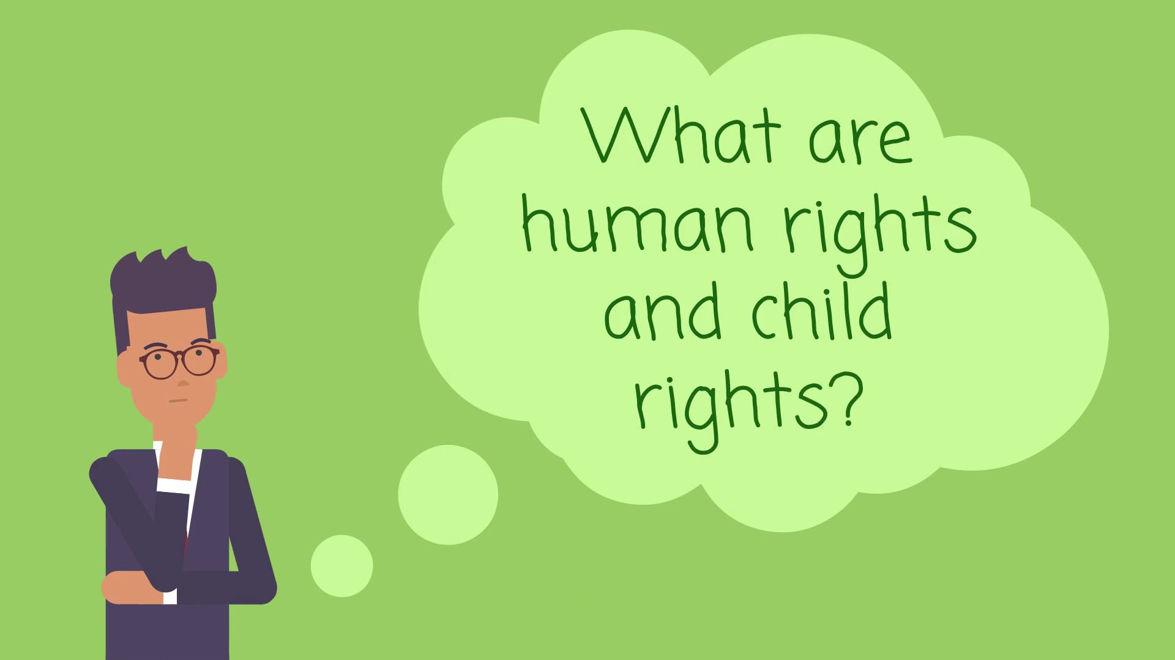
What are human and child rights?
Notes:
Script: We are going to start today’s workshop by familiarising ourselves with the concepts of human and child rights. To do this, we are going to watch an animation created by Positive Impact and Unicef UK which explores what human and child rights are and why they are relevant for events.
Show video https://www.youtube.com/watch?v=GKBrBBXhUx8

Slide 4
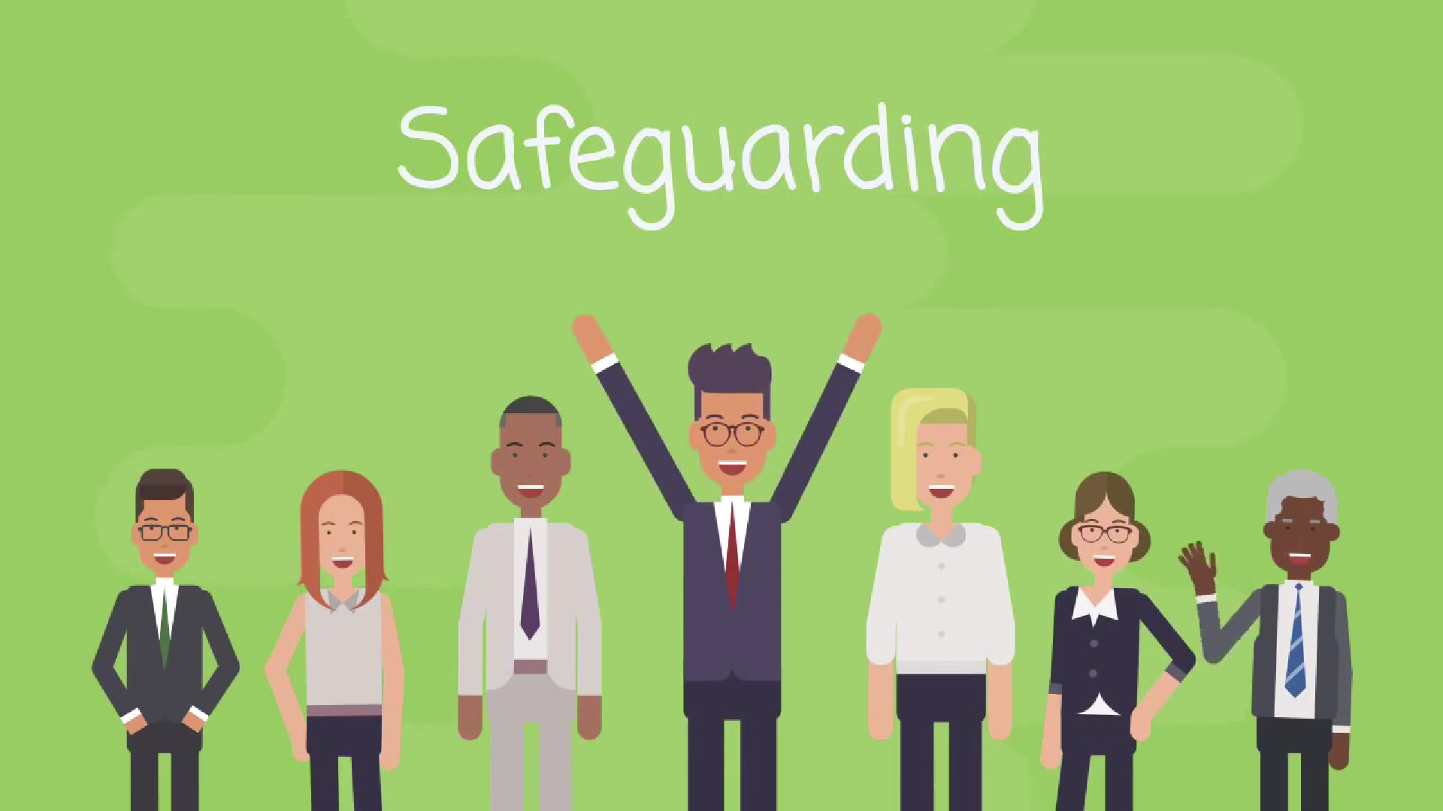
What is safeguarding?
Notes:
Now that we understand what human and child rights are, we’ll take a look at safeguarding. ‘Safeguarding’ refers to the policies, procedures and actions that event organisers should take to ensure that anyone working on their behalf, and anyone benefitting from the work they are doing, does not come to any harm, either intended or unintended because of the work taking place. Safeguarding is the prevention of or response to harm and abuse of children, young people, and adults at risk. This is an essential process for the consideration of human and child rights at your event.
We’ll watch a short animation on safeguarding now to help ensure we are all familiar with these three key elements and their relevance to event planning before we dive deeper into this session.
Show video: https://www.youtube.com/watch?v=UeC6cpBolVc

Slide 5
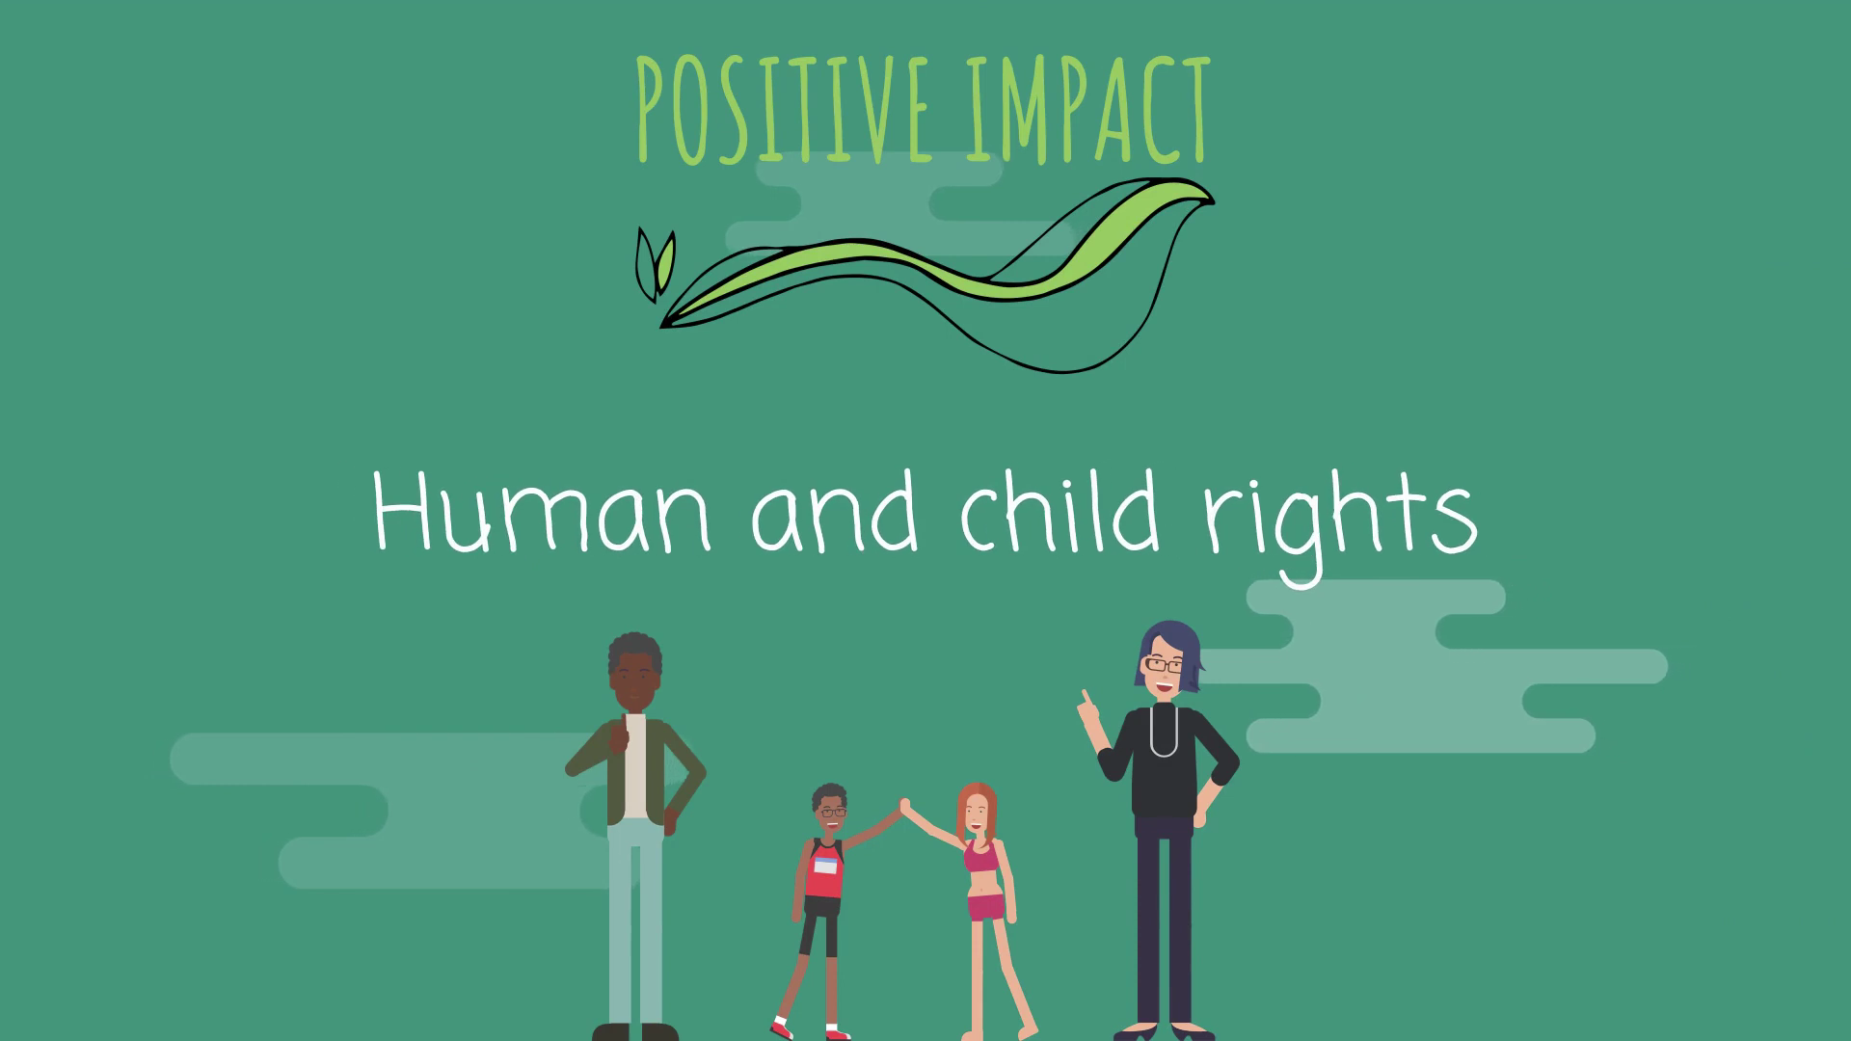
What is the guidance for considering human and child rights and safeguarding when planning an event (Annex D)
Notes:
Script: Now that we understand the concepts of human and child rights and safeguarding, we can start to explore the guidance created by Positive Impact and Unicef UK.
We are going to watch another animation, developed by Positive Impact, which outlines what the guidance is and how it can help event professionals.
https://www.youtube.com/watch?v=_CsLqzJaWk4

Slide 6
How was the guidance created
Notes:
Script: As the animation stated, this guidance was created by Positive Impact and Unicef UK when a gap was identified in the understanding and consideration of human and child rights and safeguarding in the event planning process.
The guidance was developed in line with ISO 20121 to embed human and child rights and safeguarding processes into every aspect of the event and to ensure these three crucial elements were incorporated into the event’s sustainability strategy.

Slide 7
What is ISO 20121 and how does it work
Notes:
Script: We have touched on what ISO 20121 is, but now we are going to hear from the ISO 20121 chair, Fiona Pelham, in order to gain a deeper understanding of the standard and its relevance to the event sector.
Show video https://www.youtube.com/watch?v=twkzZP7NElY

Slide 8
What is the business case for using the guidance?
It will:
Ensure your event is aligned with the UN Guiding Principles on Business and Human Rights and the concept of ‘do no harm’
Enable meaningful participation and inclusion at your events
Create a legacy from the event with a Positive Impact
Advance the social sustainability at your event in line with the growing expectations of customers and governments
Support your event strategy to advance the UN SDGs
Notes:
Script: Now we understand what human and child rights are; their relevance to the event sector; what the guidance for considering human and child rights is; and how it was created. Next, we need to explore the business case for using this guidance.
First and foremost, organisations (in particular, commercial enterprises) have a responsibility to respect human rights and ‘do no harm’ in their activities. This responsibility is set out in the UN Guiding Principles on Business and Human Rights, and requires organisations to avoid infringing on people’s human rights and to act to address any rights impacts with which they are involved. From a business case perspective, considering human and child rights makes good business sense – demonstrating your commitment to transparency, accountability, and respect for the people impacted by your activities throughout the lifecycle of your event.
Secondly, considering human and child rights in the planning of your event will create a more participatory and inclusive space. A key element of this guidance is stakeholder engagement, and the need for event organisers to engage with groups and individuals likely to be impacted by the activities around your event. Once again, this helps you to prioritise transparency and accountability, and also ensures that your event can achieve the best outcomes for everyone involved! By engaging with those people closest to the event, you’re setting your organisation up with the best opportunity to create a positive and long-lasting legacy. This, in turn, can set your event out as an example of best practice that others in the event industry can look to and learn from – and further enhance your reputation with investors. Listening to the voices and opinions of external stakeholders will also better equip you to draft and implement policies on equality, diversity and inclusion, and rights and safeguarding.
Thirdly, we know that consumers are increasingly more willing to invest in businesses who listen to them, and who are visibly giving back to local communities and “good causes”. The flipside of this, of course, is the detrimental impact of not listening to consumers and fans – for example, businesses having a negative environmental impact or those in the fashion industry found to be sourcing goods from factories without health and safety standards or living wages. This increase in conscious consumers has led to demands for greater transparency in business practices – meaning that now is a good time to start embedding rights and safeguarding good practice at the core of your brand. There is also room to go one step further, and utilise the learnings from this guidance to leverage those goods and services providers within your supply chain to adopt similar policies.
Lastly, by considering human and child rights at your event, you’ll be advancing many of the UN Sustainable Development Goals – such as SDG 10 to reduce inequality, SDG 5 to advance gender equality and SDG 16 to promote peace, justice and strong institutions. In short, there is a wealth of opportunity with this guidance!

Slide 9
How will the guidance help event planners?
Notes:
Script: The guidance will equip event organisers with knowledge of;
Their responsibility to respect human and child rights through frameworks like the UN Guiding Principles on Business and Human Rights – including the duty to provide access to remedy
Key terms and actions required when planning an event that prioritises rights and safeguarding
How to conduct stakeholder engagement and who to include – such as groups and individuals in the local community who might be impacted by your event
Key questions to consider to ensure your operational plans consider rights and safeguarding
And lastly – how and what to monitor and report on during the event lifecycle to ensure the consideration of human and child rights and safeguarding.

Slide 10
Exercise to help event planners understand how to implement the guidance
Notes:
Script: So now we are going to carry out an interactive exercise to help you understand how to implement the guidance and what sort of steps you will need to take.

Slide 11
List all stakeholders affected by your event
Notes:
Script: So first, can you please try to list all of the stakeholders who would be affected by your event taking place. Think about every aspect of your event and every possible person who could be affected by your event taking place. I will give you 5 minutes to write down a list of these individuals.
Now we have noted all the stakeholders down, let’s collate them on a whiteboard.

Slide 12
Examples of Human rights
Article 5 – Right not to be subjected to torture or to cruel, inhuman or degrading treatment or punishment.
Article 8 – Right to an effective remedy for acts violating their fundamental rights.
Article 12 – Right to privacy and family life.
Article 18 – Right to freedom of thought, conscience and religion.
Article 19 – Right to freedom of opinion and expression.
Article 20 – Right to freedom of peaceful assembly and association.
Article 25 – Right to an adequate standard of living.
Article 27 – Right to participate in the cultural life of the community.
Notes:
Script: Now let’s look at some examples of human and child rights, and how your event might impact them. We will need to bear these in mind in relation to those stakeholders we identified in the last exercise. Here is a selection of rights taken from the UN Declaration on Human Rights, which are perhaps most likely to be impacted by events and their activities.
For example, Article 8 highlights the right to an effective remedy. The Annex D guidance sets out the importance of access to remedy and equips event organisers to establish remedy mechanisms within their event planning. It is crucial that those impacted by your event have an accessible and transparent grievance mechanism in order to voice any concerns or report infringements on their rights. The obligation to provide remedy mechanisms is also echoed by the UN Guiding Principles on Business and Human Rights.
Articles 18, 19 and 20 could relate to enabling athletes or performers to speak freely or share their political opinions; or ensuring that members of the local community have their voices heard and can input into the planning and delivery of the event.

Slide 13
Examples of Child rights
Article 3 – The best interests of the child must be a top priority in all decisions and actions that affect children.
Article 12 –Right to express their views, feelings and wishes in all matters affecting them, and to have their views considered and taken seriously.
Article 19 – Right to protection from violence, abuse and neglect.
Article 27 – Right to an adequate standard of living.
Article 28 – Right to education.
Article 32 – Right to protection from child labour.
Article 34 – Right to protection from all forms of sexual abuse and exploitation.
Article 37 – Right to protection from inhumane treatment and detention.
Notes:
Here is a selection of rights lifted from the UN Convention of the Child, which are perhaps most likely to be impacted by events and their activities.
For example, Articles 3 and 12 emphasise the need for event organisers to engage with stakeholders such as those in the local community to ensure children’s views are heard and the best interests of the child are considered.
Articles 19 and 34 highlight the need for robust child rights and safeguarding policies. These rights would be negatively impacted if there wasn’t sufficient protections in place for child athletes participating in a sporting event – or children living in the local community, who might face harassment by security personnel or venue construction workers.
Article 28 might be impacted, for example, if transport in the area is re-routed to facilitate your event and children in the local community have no access to public transport to attend school or college.

Slide 14
Examples of potential rights impacts
Affected group | Description | Potential impacts
Athlete/participant/ performer | People who take part in the content of and/or focus of the event | e.g. media intrusion, lack of privacy, harassment, racism
Children | Any person under the age of 18 | e.g. vulnerable to abuse, child labour, trafficking
Local community & residents | People residing near the location of the event, including adults & children who live on the streets, refugees & undocumented migrants. | e.g. forced evictions due to venue construction
Persons with disabilities | This includes those who have long-term physical, mental, intellectual, or sensory impairments which in interaction with various barriers may hinder their full & effective participation in society on an equal basis with others. | e.g. lack of accessible facilities (for example, bathrooms or changing areas) at venue.
Volunteers | People who voluntarily work on the event in an unpaid capacity. | e.g. long working hours or poor working conditions
Notes:
This is an extract from a table contained within the Annex D guidance, and will be helpful for our current exercise. You can see the stakeholder – or affected group – set out in the left column, with a brief description of this stakeholder, and then some examples of the potential human or child rights impact associated with that individual or group. These examples are by no means exhaustive, and we encourage you to think of other potential impacts on your list of stakeholders – having seen the human and child rights examples set out in the previous two slides. You can find the full version of this table in the Annex D guidance.

Slide 15
Human rights impact assessment
Notes:
Script: Now we are going to carry out a brief human right impact assessment on the stakeholders identified. This will just be a top-level exercise – a real-life rights impact assessment will decidedly require more time and effort! Let’s go through each stakeholder and aim to identify potential impacts and risks to their human rights. These impacts could include an infringement on rights such as: the right to health or education; the right to freedom from discrimination; the right to decent working conditions; the right to privacy; or the right to rest and leisure – or any of the rights we just addressed.
I will give you 7 minutes to do this.
Now let’s discuss what we’ve come up with. I am going to go round and I want each of you to share 2 stakeholders and their possible corresponding human rights impacts.

Slide 16
Other Practical steps to take to consider human and child rights and safeguarding when planning your event
Meaningful participation
Remedy
Notes:
Script: Now we have carried out the interactive exercise to give you an idea of what it is like to implement the Annex D guidance in line with ISO 20121 processes, we are going to explore practical actions to be considered to reduce the human and child rights impacts that we identified in the previous exercise.
Meaningful participation is the ongoing consultation with ‘affected groups’ and those at-risk of safeguarding-related harm, with methods of engagement tailored to enable at-risk individuals and, for example, children, to express their views. To carry out meaningful participation, an event organiser should be consulting, through stakeholder engagement, with all affected groups before, during and after the event.
Meanwhile, access to remedy is another priority for event organisers, and one that we touched on briefly earlier. Pillar three of the UN Guiding Principles on Business and Human Rights highlights the need for access to remedy, demonstrating just how crucial it is. Remedy is the process of understanding, preventing, mitigating, and addressing human rights impacts on people. Event organisers must put in place a process – such as a grievance mechanism – to enable potential victims to access effective remedy for any harm the event has caused or contributed to: in other words, “making good a harm” or restoring the former condition prior to the harm, where possible. This ties in with the need for event organisers to go beyond their duty to ‘do no harm’ throughout the lifecycle of their event, and go as far as ‘doing good’ – through respecting and protecting human and child rights and safeguarding in all aspects of planning, delivery and legacy.

Slide 17
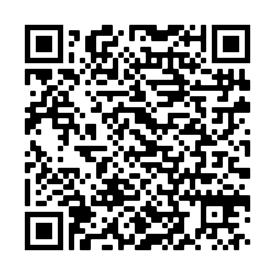
Access all the considering human and child rights educational materials
Notes:
Script: Positive Impact and Unicef UK have created educational materials for each of these practical steps for event planners to take. Scan this QR code to access the human and child rights hub on the Positive Impact webpage and work through all of these educational materials to support your implementation of the Annex D guidance.

Slide 18
Outcomes from presentation:
Understand human and child rights and safeguarding
Understand why it is important to consider human and child rights and safeguarding when planning an event
Be equipped to implement guidance to consider human and child rights and safeguarding in line with ISO 20121
Learn practical steps to take to consider human and child rights and safeguarding when planning your event
Notes:
Script: So, after listening to this presentation, you should:
be familiar with the concepts of human and child rights and safeguarding
understand why it is important to consider these three key elements when planning an event, and
be equipped to implement guidance to consider human and child rights and safeguarding in line with ISO 20121.
The call to action for everyone here today is to look through all the other training materials available on the Positive Impact website – including reading the frequently asked questions, watching the interview with Unicef UK, and – most importantly – read the guidance itself.

Slide 19
Please contact
sophie@positive-impact-events
if you have any further questions
Notes:
Script: If anyone has any further questions, please reach out to Sophie Thesiger from Positive Impact and she should be able to answer any of these.
Furthermore, please email Sophie if you would like additional support on implementing the human and child rights guidance as well as to work in collaboration on your sustainable event strategy.

Slide 20
Thank you!
#eventscreatechange

